Slide 1
Module 4: The vacillating Giant
Talk | Title | Time Period | Date of Talk
23 | USA and the 20th Century | 1898-1900 | September 2nd
24 | The Progressive era | 1900-1916 | September 16th
25 | USA and world War One | 1914-1918 | October 21st
26 | The retreat to “normalcy’ | 1918-1920 | November 4th
27 | The Roaring Twenties | 1921-1929 | November 18th
28 | Great Depression and New Deal | 1929-1941 | December 2nd
29 | USA and the 1930’s world | 1932-1941 | December 16th

Slide 2
American History
1
Talk 27: Roaring Twenties (1921-1929)

Slide 3
The Roaring Twenties
Rule of the Republicans
The Consumer Society
Race, gangsters and speculation
Wall Street Crash

Slide 4
American History

Slide 5
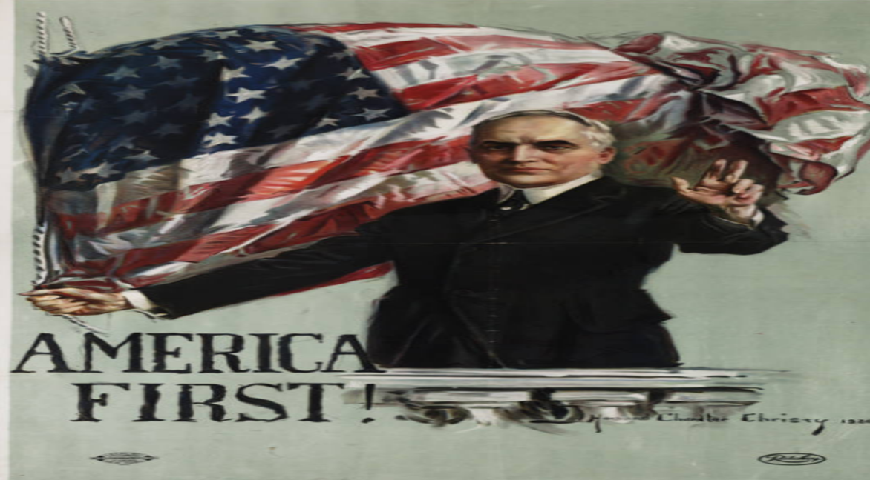
President Harding

Slide 6
Harding Presidency
Rated as most inept US President ever….an unfair assessment
Verdict based on private life “ thank God I’m man, if not I should be forever pregnant”…release of letters after death
Progressive record internationally
Widespread domestic corruption…and lots of philandering

Slide 7
Harding: US and the pot war world
Peace….everywhere
Bi-Lateral Peace Treaties/ rejection of Treaty of Versailles
Observer but not member of League of Nations
Ends intervention in Russian Civil War
US army leaves Cuba, compensation paid to Colombia for Panama
Dawes Plan…reduces German reparation payments and reschedules
Washington Disarmament Conference 1921: end arms race
Agreed battleship ratios (5:5:3 deal…US & UK equal, Japan 3/5 ratio)
Major achievement….US response to famine in Russia

Slide 8
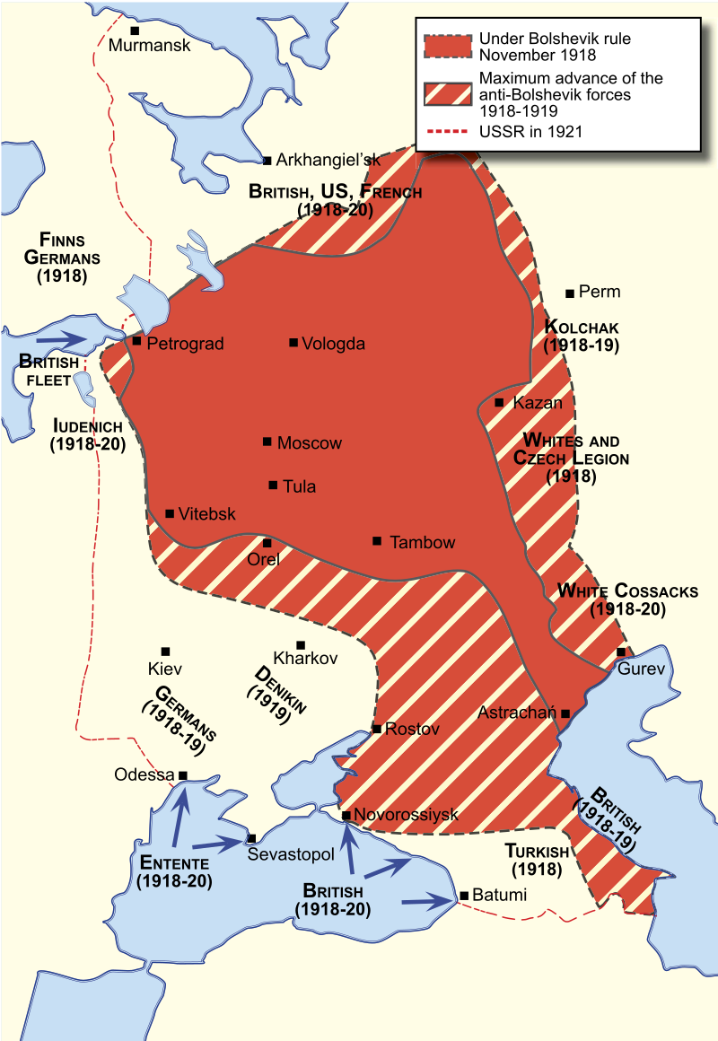
Russian chaos
Widespread war across
Eastern Europe
..collapse railroads
..mass armies
Bolshevik policies
..abolishment of money
…crop seizures
..”war communism”
..Food as weapon
..Red Terror. Killings by quota
Famine breaks out 1921

Slide 9
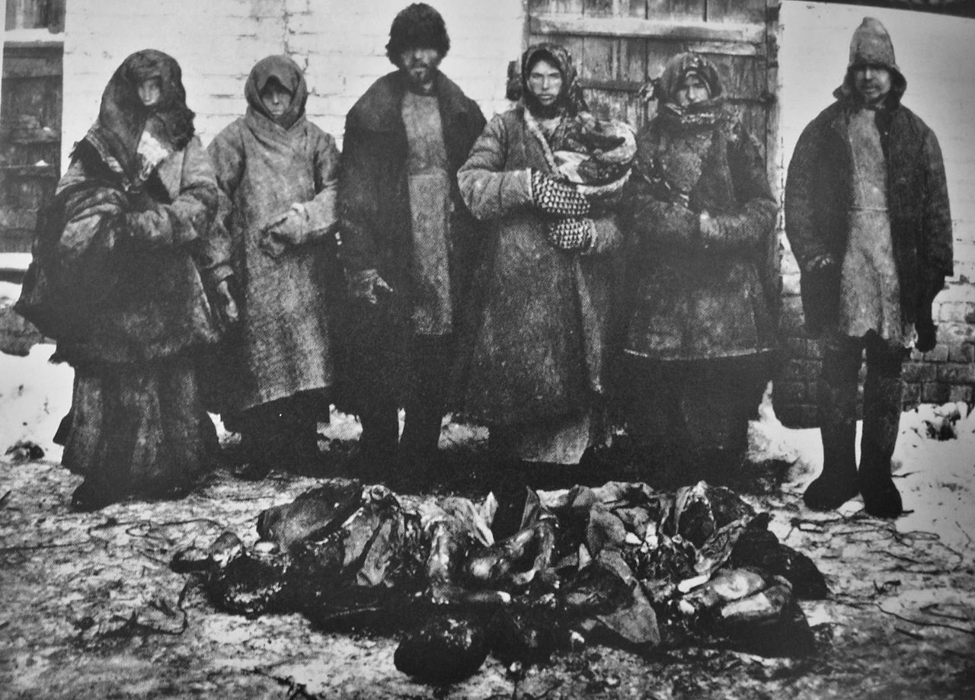
Russian Famine 1921-1922
Parents and children (food)
News suppressed
Bolsheviks embarrassed/dogmatic
West. Blames “communists”
Norwegian Fridtjof Nansen..explorer/ humanitarian
And trusted.collects reports/ photos
…widespread cannibalism (20% survivors)
…"it was dangerous for children to go out after
dark since there were known to be bands of
cannibals and traders who killed them to eat or
sell their tender flesh."
Lenin appeals for help …from anyone
..abandons demand to control distribution

Slide 10
American Relief Association
Herbert Hoover Commerce Secretary
.. Led Belgian Relief effort
…humanitarian and businessman
…offers aid to Russia 1919 if US retains control
..save lives, even if it means saving communism
ARA response to Lenin appeal
…300 employees, 120,000 Russians
…fleet of 237 ships to Russia
…10 million fed for two years
…US approves $20 million
Lenin adopts “New Economic Policy” 1924
…Ends “war communism”
…crops restored
First world Famine Relief…hugely successful
Hoover a hero, intervention ‘forgotten’

Slide 11
Harding administration: domestic agenda
Economic
Increase in tariffs to protect industry
Reduce income tax for rich….blocks “bonus” for veterans
Post war recession continues…unemployment 11%
Release of political prisoners from war (Eugene Debs)
Immigration restrictions based on “national origin”: 3% population @ 1910 rule
Quotas set favouring Northern Europe/ German/ Irish
Eliminate immigration from China and Japan
Harding administration remembered only for scandals

Slide 12
Scandals
Teapot Dome
Federal (Indian) land opened for oil drilling. New company
Licenses awarded without bidding …payments to Secretary of the Interior
$100K bribe to secretary
Company founder, sales agent kill each other, secretary jailed
Veterans Affairs
Appointee secures $200 million ($2Bn today) kickback from hospitals medicine
Secretary commits suicide on investigation….after shooting accuser!
Affairs: 7 simultaneous mistresses while in white house

Slide 13
Harding…..end game
1929/20 economic depression 11% unemployment
Rumours of scandal
Embarks on “Voyage of Discovery” across USA 1923
Refresh….prepare for 1924 election /meet the people
escape mistresses
Wife Florence joins him
Harding dies of heart attack on train
…in arms of wife….romantic, tragic, surprising

Slide 14
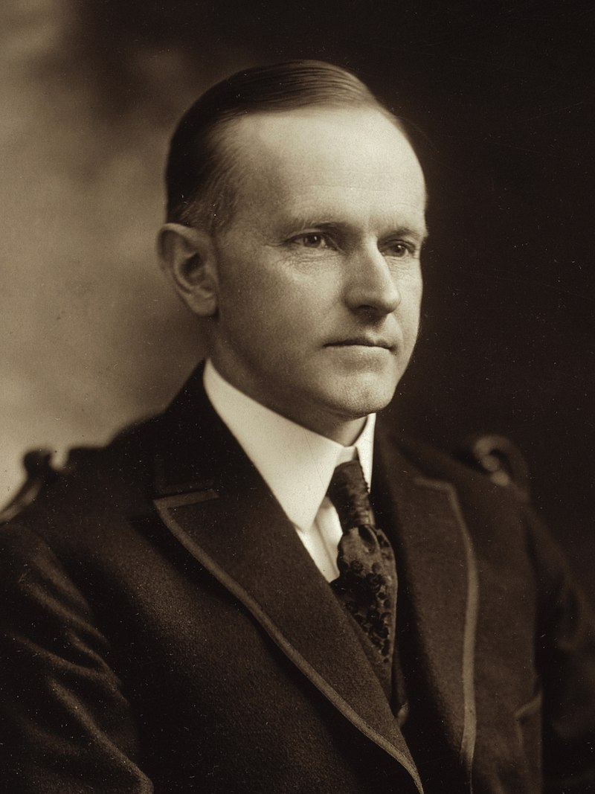
“Silent Cal”…(President 1923-1928)
Calvin Coolidge 1872-1933
Dour, smart, quiet, methodical
Middle class background
Massachusetts lawyer politician
Mayor of Boston. Crushing Boston Police Strike
Governor of Massachusetts
Nominated VP with Harding
Assumes Presidency on Harding death
Retains Cabinet
Allows prosecutions to continue
Minimal government, debt reduction
Non interference states

Slide 15
Coolidge as President: 1921-1924
Focus on business
Economy recovers from post war recession….new industries, rise in wages, world trade
Reduce taxes, increases tariffs, deregulates banks/ reduces debt
Disinterested in international affairs
Offers to join world court….but only if verdict don’t effect USA
Supports disarmament….ineffectual follow on from Washington Treaty
Applies “Roosevelt Corollary”…temporarily occupies Nicaragua, Dominica Haiti “proper government”
“

Slide 16
Coolidge Quotes
“After all, the chief business of the American people is business. They
are profoundly concerned with producing, buying, selling, investing and
prospering in the world.”
“I think the American people want a solemn ass as a President,…and I think I will go along with them”
Man of few words….or none at all

Slide 17
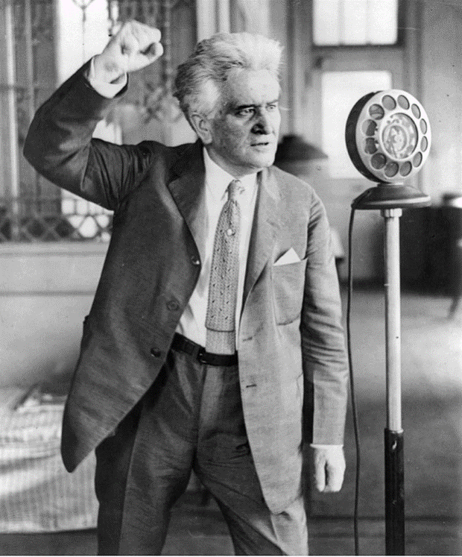
Election of 1924: The last "Progressive” Republican
Son of farmer , scholarship
Lawyer, District Attorney, State Senator
Republican Governor of Wisconsin
Robert La Folette (1855-1925)
Populist and reformer
..Primary elections/female suffrage
..opposes monopolies
…price controls of railroads
…opposes WW1….idea of bankers
…breaks with Roosevelt…too radical
Loses nomination to Coolidge and
creates “Progressive Parry
opposes WW1 entry
…opposes League of nations
…against imperialism/ Pro Bolsheviks
…till actually visits USSR ….changes view
…civil rights/ public ownership

Slide 18
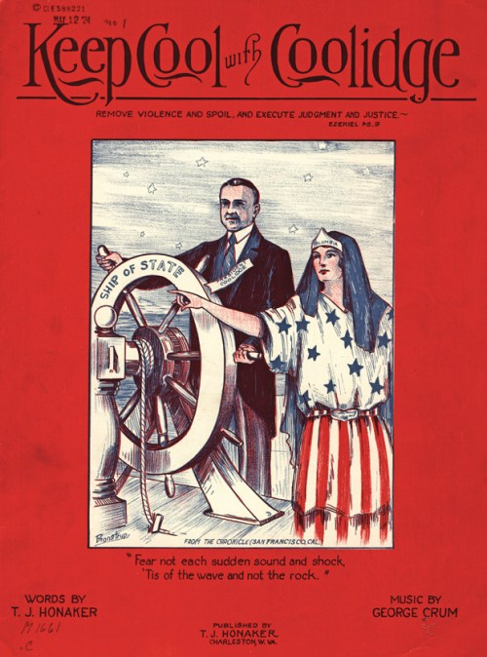
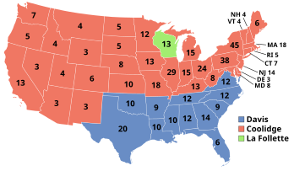
Election of 1924
Economy booming
Republicans re-elect Coolidge
….no comments
Republican landslide (386 electors 54%)
Dems split…”Solid South” 136 vs 28%
Progressives ’13 (Wisconsin) 17%...disappear’

Slide 19
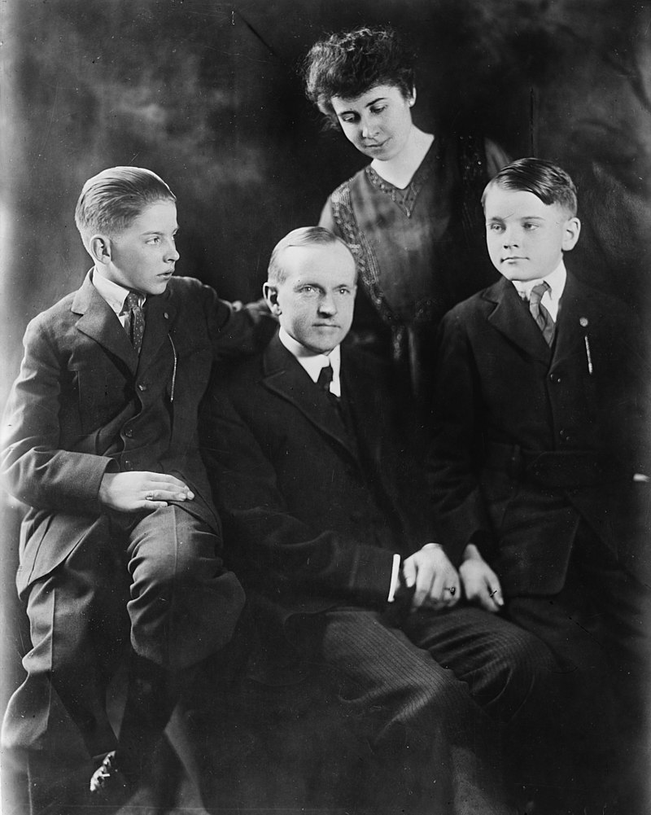
Coolidge 2nd Term 1924-1928 by tragedy
Coolidge and family 1918
Wants….quiet life
Loses youngest son
John to sepsis
….tennis match
Clinically depressed
1926….withdraws to
White House
Delegates power to
Andrew Mellon .finance
Herbert Hoover: business

Slide 20
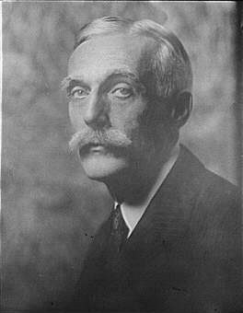
Financial Management of Roaring Twenties
Scientific taxation
…rejects “redistribution of taxes
...lower taxes increase revenue
...eliminate “gift tax”, reduce “estate tax”
...’trickle down economics”
…reduces marginal tax 70% - 26%
Andrew Mellon 1855 -1937)
Minimize government
…reduce regulations, relax bank reserves
Farming crisis….over production/ falling prices
…farmers increase production
…increase intensive ploughing,
…prices continue to fall, demand subsidies
Coolidge “farming always a bad business.”

Slide 21
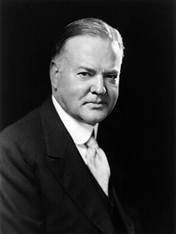
Herbert Hoover: American Hero
Quaker family Father blacksmith
….fails all exams except math
… graduates from Stanford as geology
Herbert Hoover (1874-1961)
Business career
…Cashes in on knowledge…globally
…Business consultant mining industry
Ultra Conservative writer vs Socialism
Humanist
….Rescues 100,000 stranded Americans
…Creates Belgian relief agency
…Post war organises Russian famine relieve
“twenty million people are starving. Whatever t
heir politics, they shall be fed”
Director of Commerce 1921-1928

Slide 22
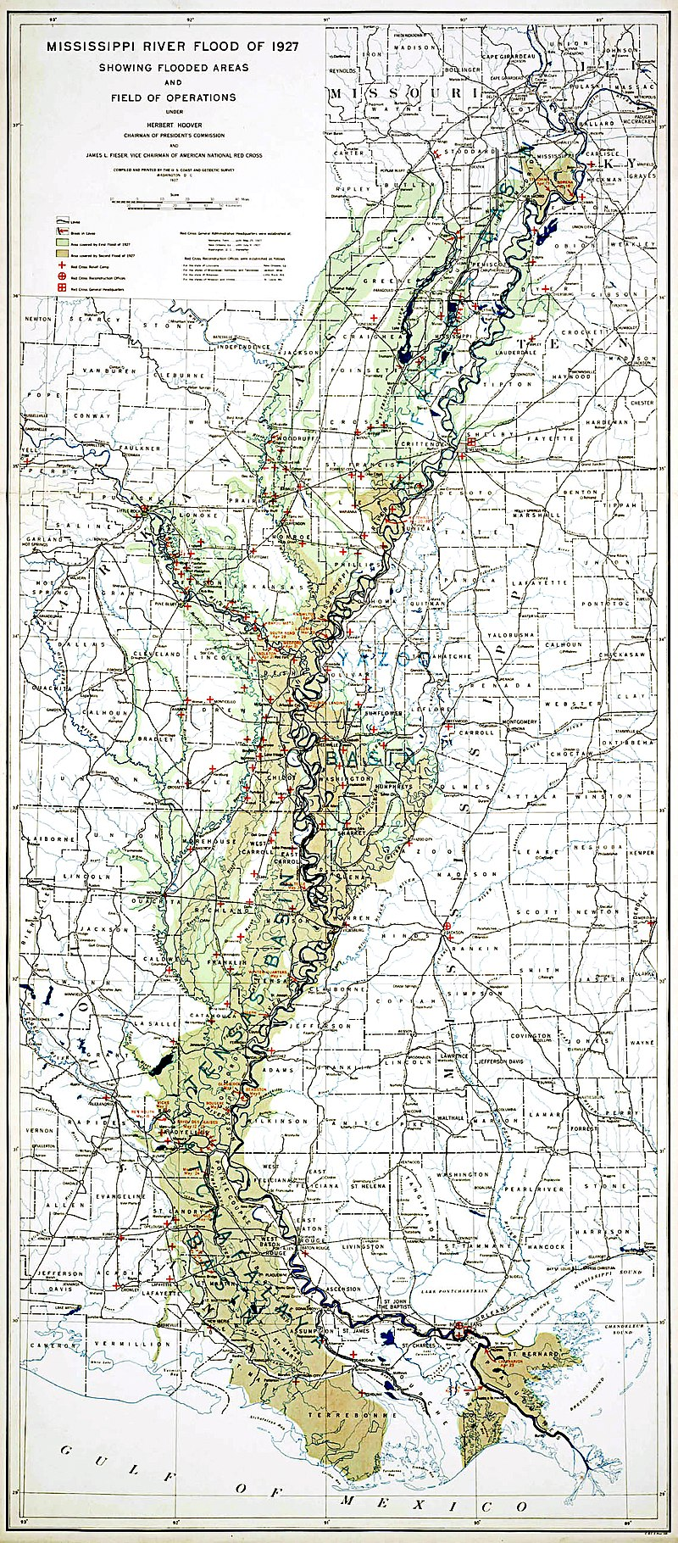
Great Mississippi Flood of 1927
500 killed, 250,000 lose home
600,000 displace, 20BN damage
…80% displaced black
Coolidge….no response
Congress demands action
….Coolidge signs relief bill
…Herbert Hoover “Mr Fixit”
Mass flood mitigation effort
….no cash relief
… engineering works vs flood
…use of forced labour
fuels more immigration north
…Hoover National hero

Slide 23
Election of 1928
Coolidge refuses 3rd term
Hoover nominated on first ballot….hero of capitalism
“given the chance to go forward with the policies of the last eight years, we shall soon with the help of God, be in sight of the day when poverty will be banished from this nation".
Democrats
Appeal to immigrants from Ireland
Assume progressive ideas of La Folette
Rising tide of reaction vs Prohibition
Opposed to rising power of (anti Catholic) KKK
Elect Al Smith first Catholic candidate

Slide 24
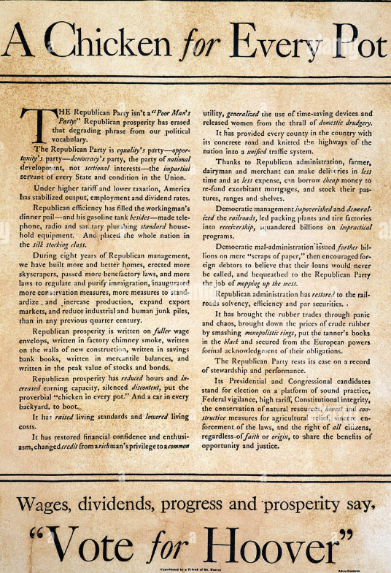
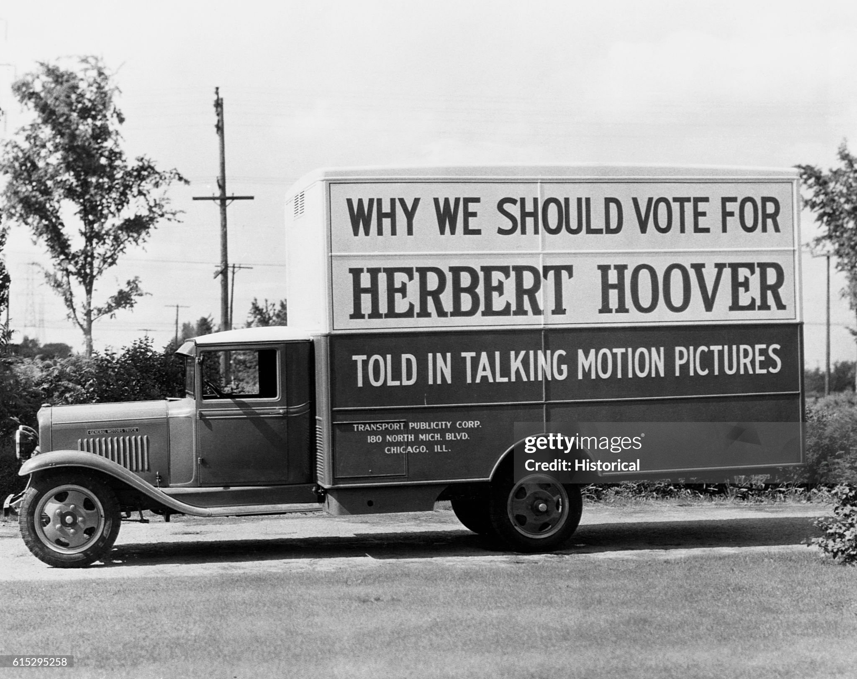
Republican: well organised…appeal to prosperity

Slide 25
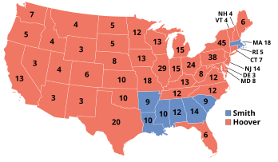
1928 Republican Landslide
Republicans chose “Hero” …Hoover
Democrats Al Smith..first
Catholic candidate anti Prohibition,
Prosperity wins
Anti Catholic campaign
Klu Klux Klan…north and west
Republicans 444 electors ..58%
Democrats 87 electors 41%
Prohibition 0, 1%
….Smith takes South
Republicans set to rule the
Land for next decade
….what could possibly go wrong?

